Slide 1
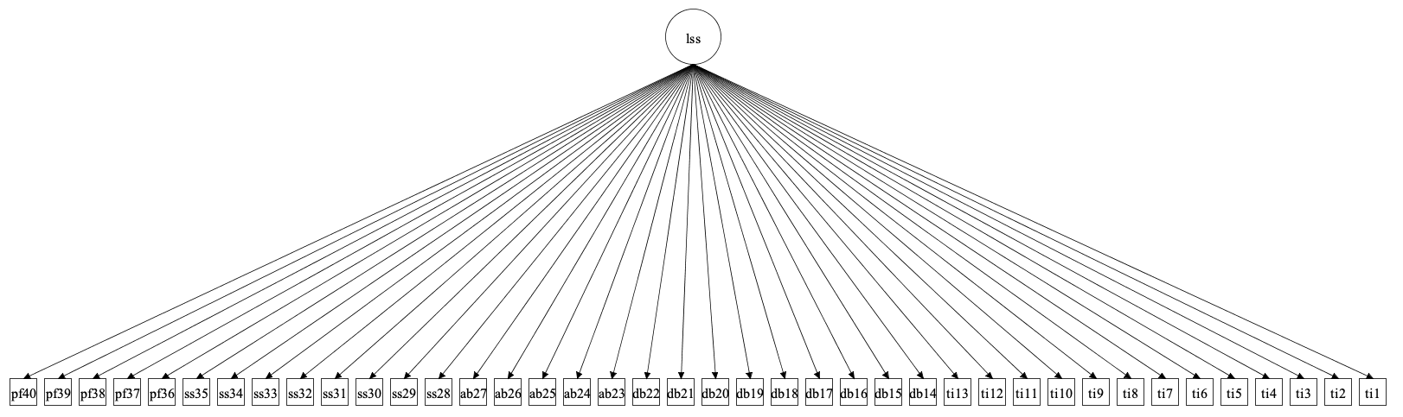
Model 1. LSS Unidimentional Model

Slide 2
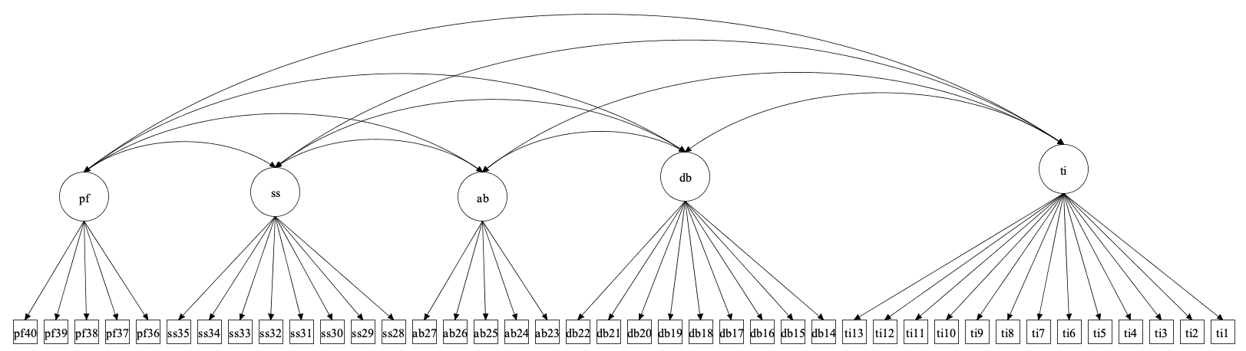
Model 2. LSS first-order 5-factor

Slide 3
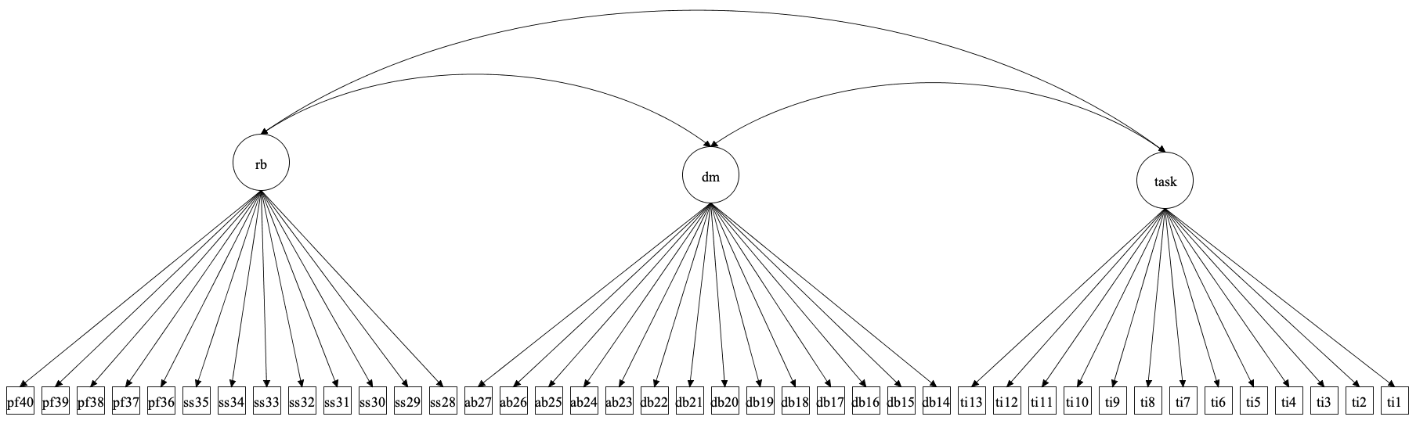
Model 3. LSS first-order 3-factor (a)

Slide 4
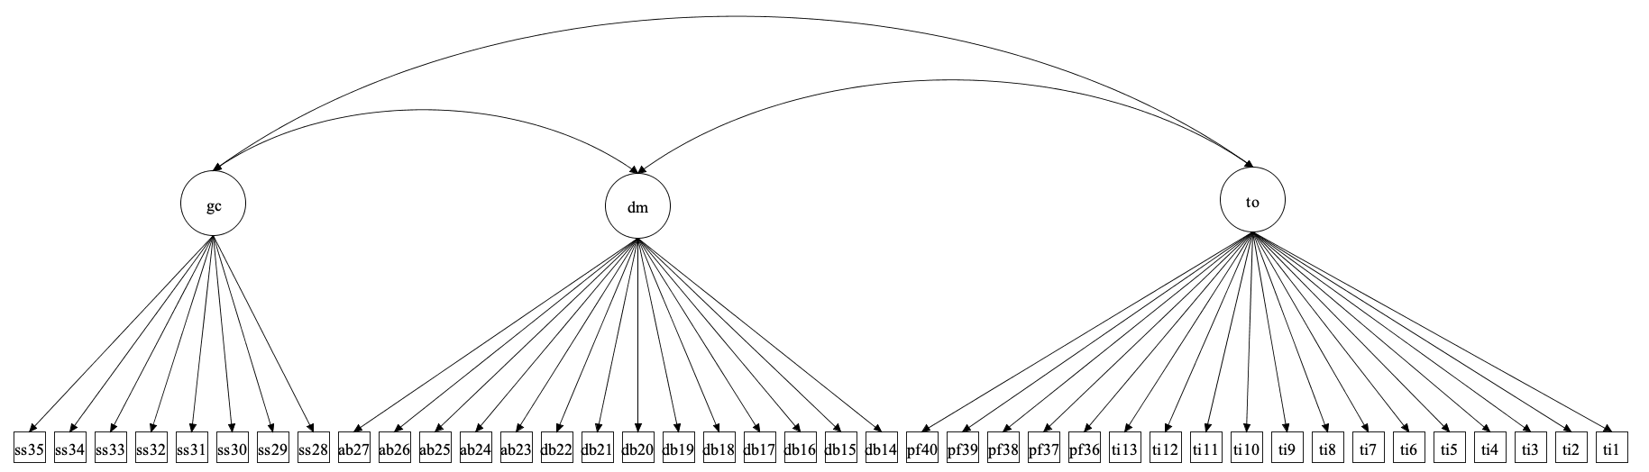
Model 4. LSS first-order 3-factor (b)

Slide 5
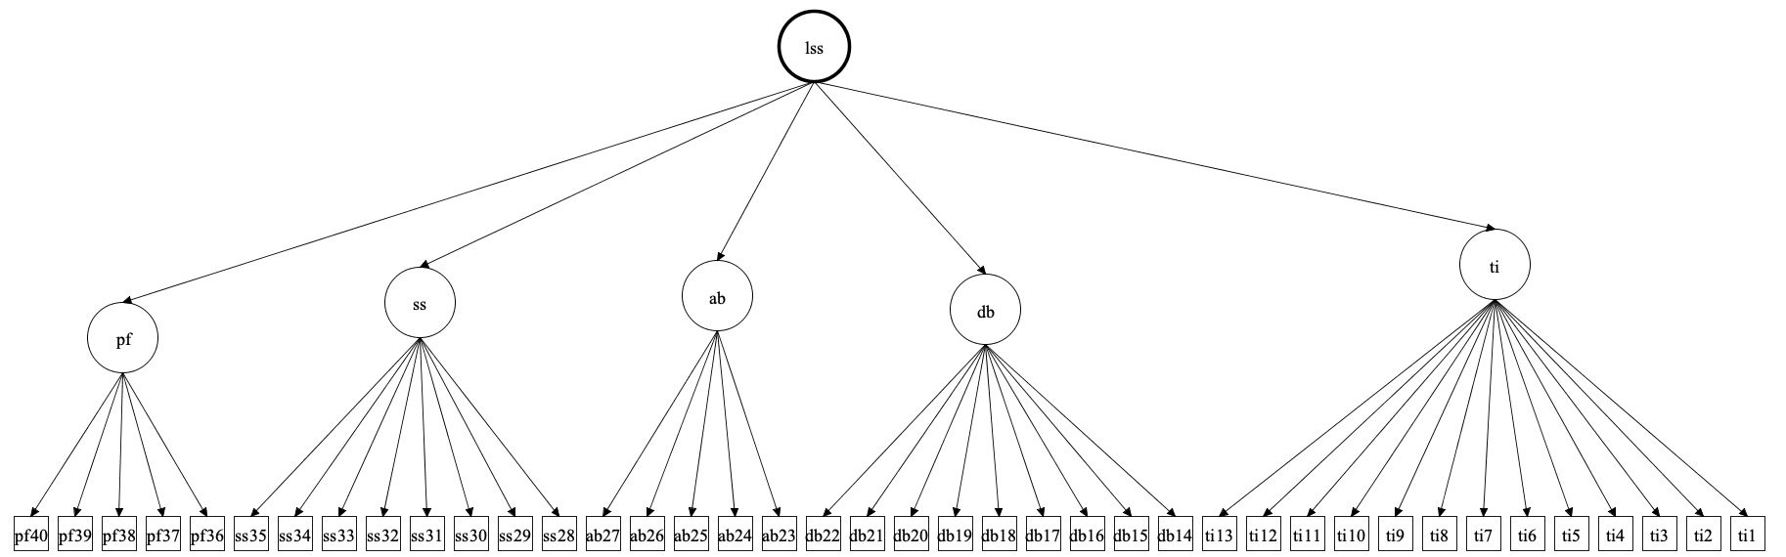
Model 5. LSS second-order 5-factor

Slide 6
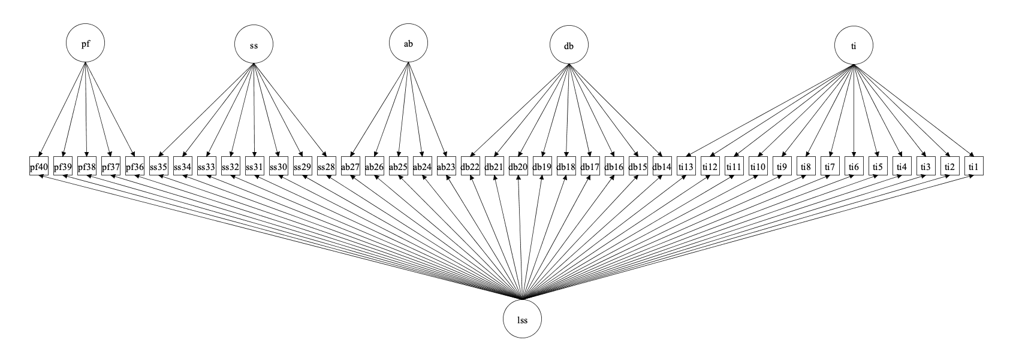
Model 6. LSS Bifactor

Slide 7
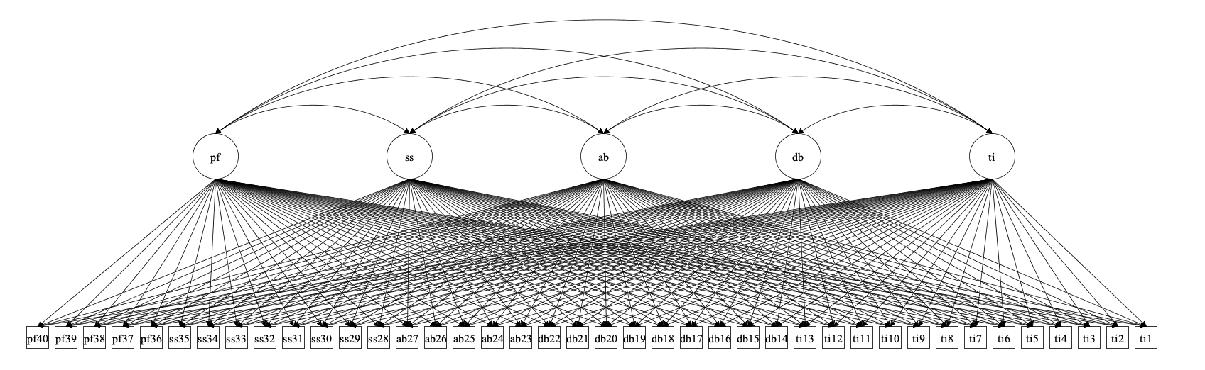
Model 7. LSS ESEM first-order factorial

Slide 8
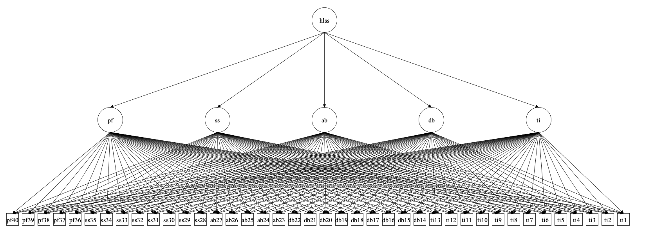
Model 8. LSS Hierarchical ESEM

Slide 9
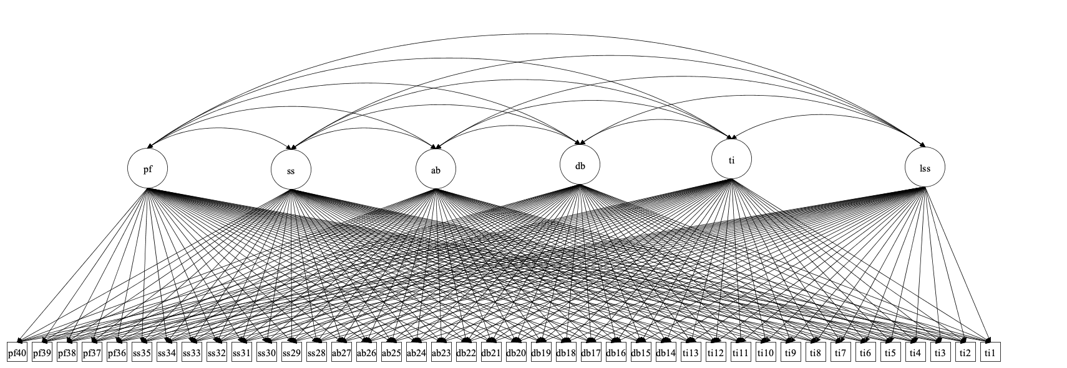
Model 9. LSS ESEM bifactor

Slide 10
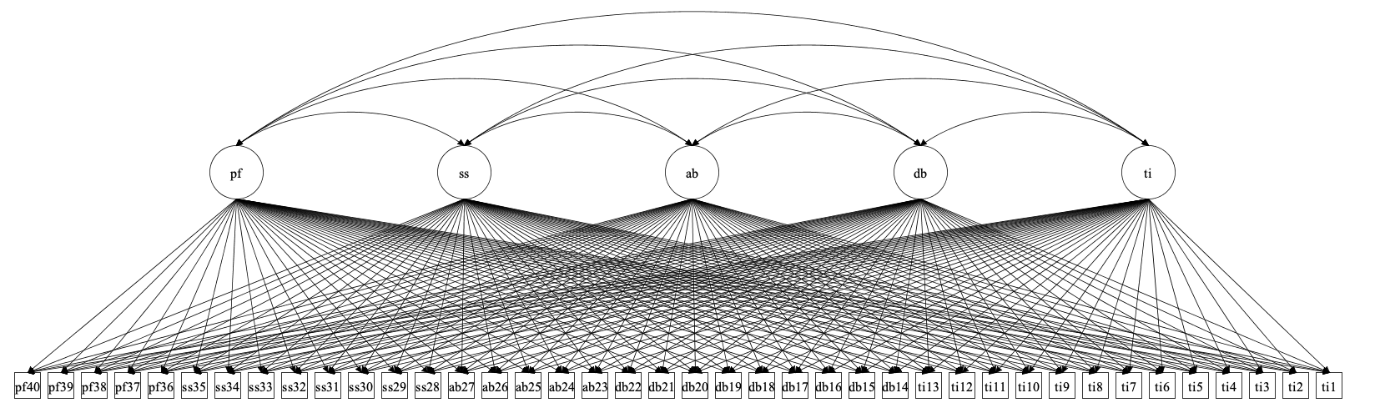
Model 10. LSS ESEM within CFA first-order

Slide 11
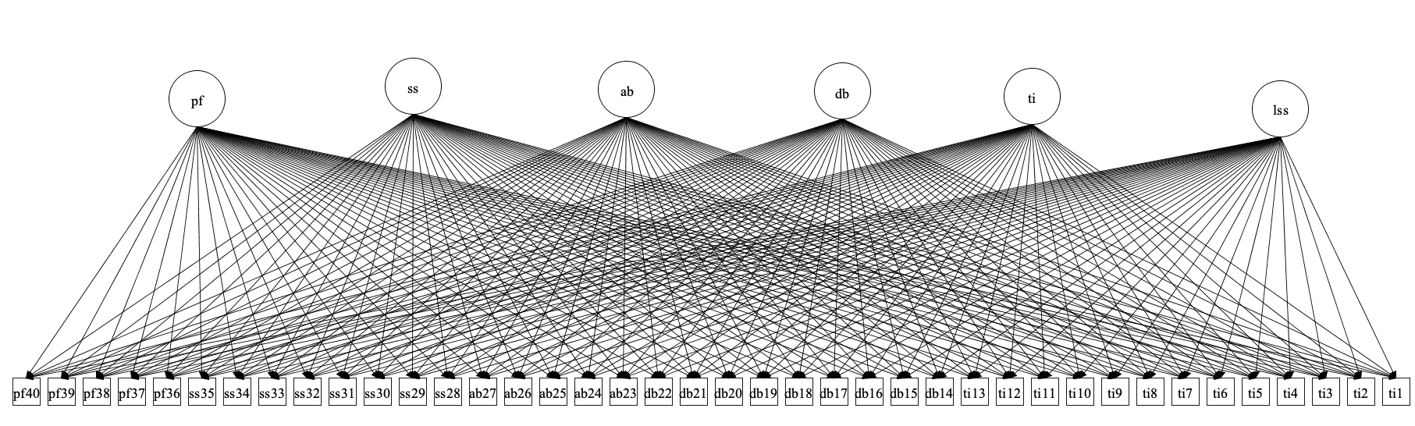
Model 11. LSS ESEM within CFA bifactor

Slide 12
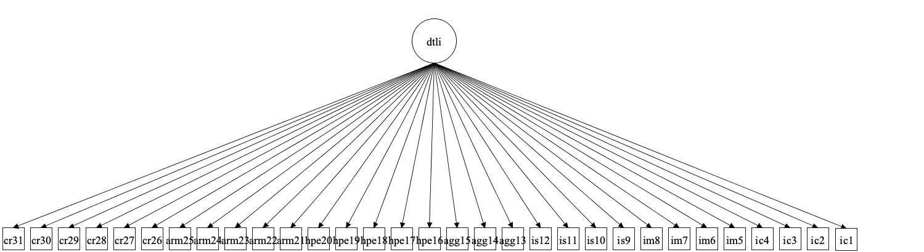
Model 12. DTLI unidimensional model
Notes:
Model 12

Slide 13
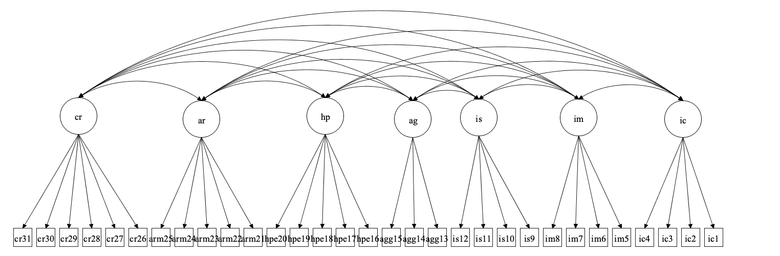
Model 13. DTLI first-order 7-factor
Notes:
Model 13

Slide 14
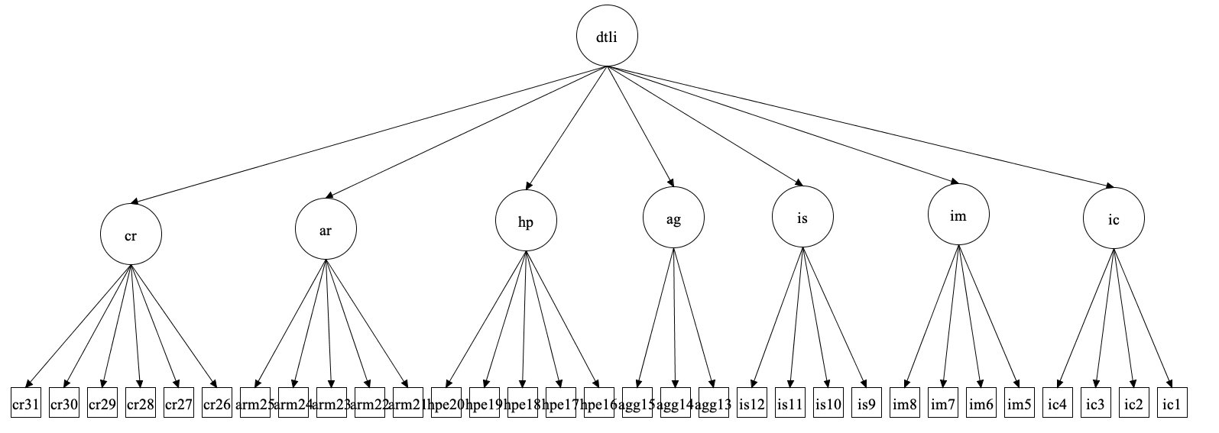
Model 14. DTLI second-order 7-factor
Notes:
Model 14

Slide 15
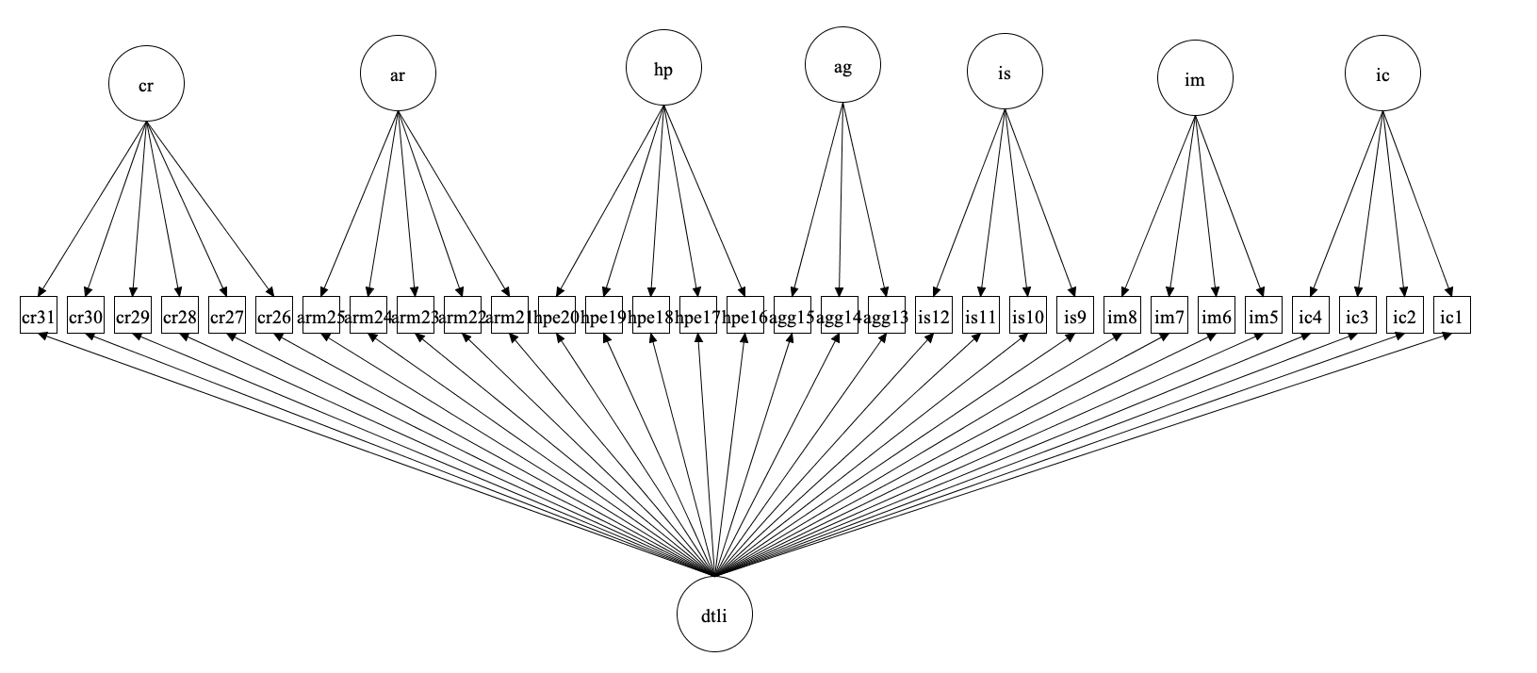
Model 15. DTLI bifactor
Notes:
Model 15

Slide 16
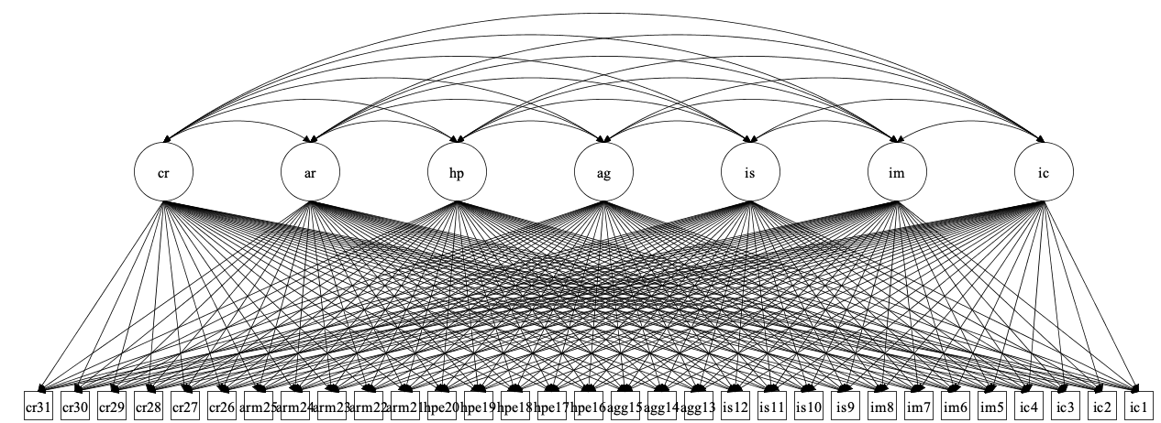
Model 16. DTLI ESEM first-order factorial
Notes:
Model 16

Slide 17
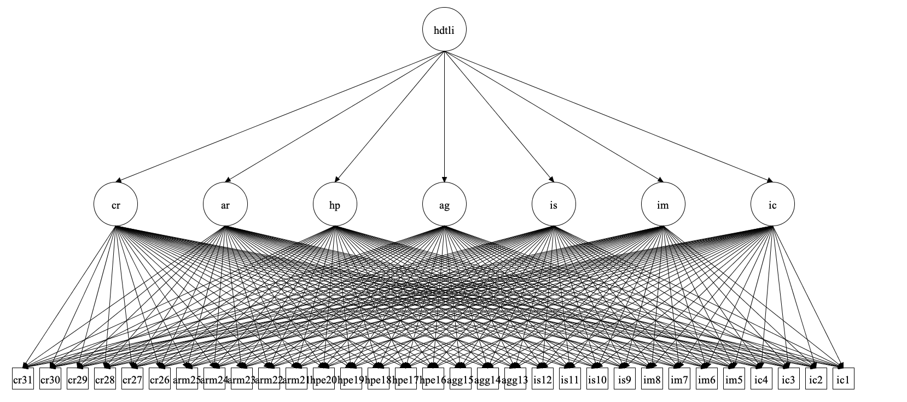
Model 17. DTLI hierarchical ESEM
Notes:
Model 17

Slide 18
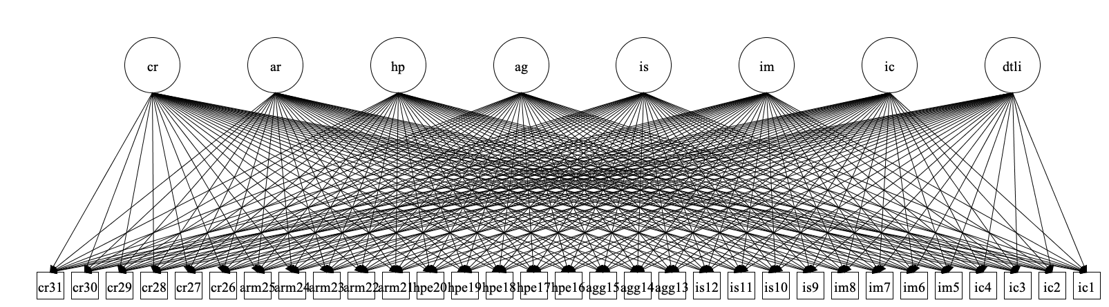
Model 18. DTLI ESEM bifactor
Notes:
Model 18

Slide 19
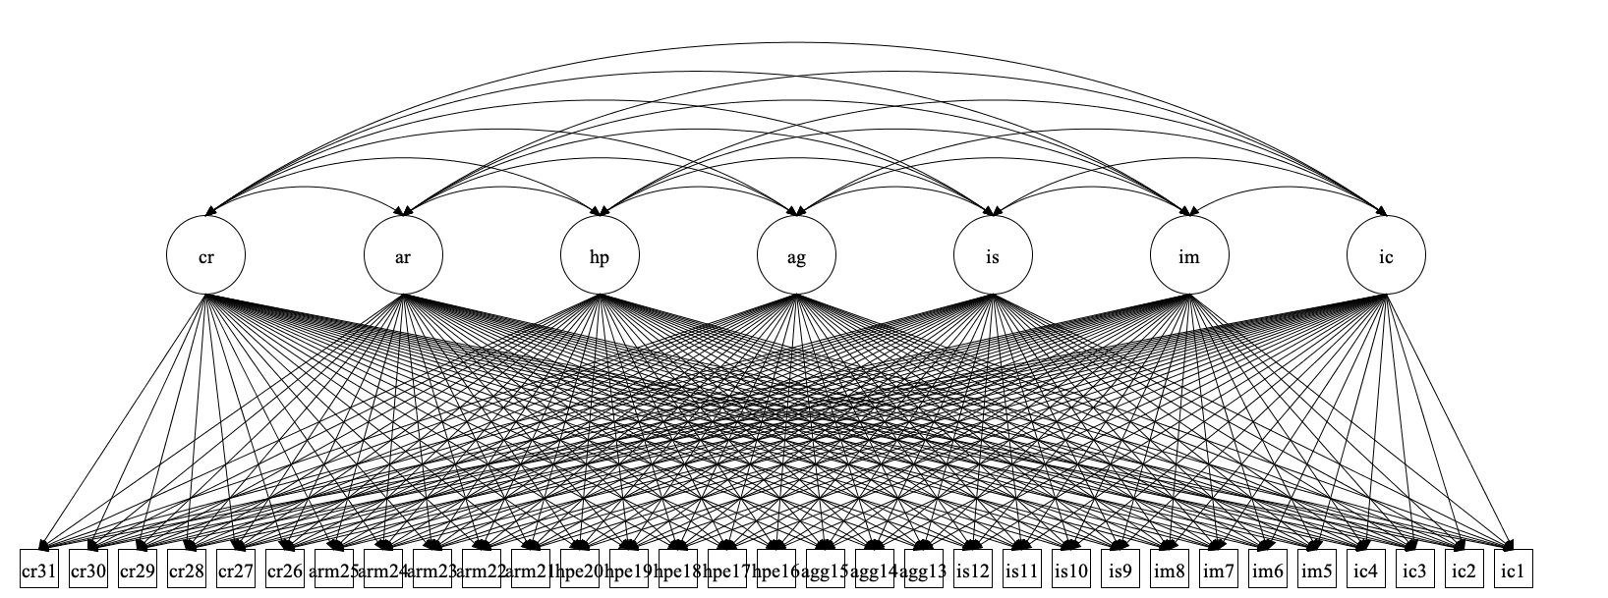
Model 19. DTLI ESEM within CFA first-order
Notes:
Model 19

Slide 20
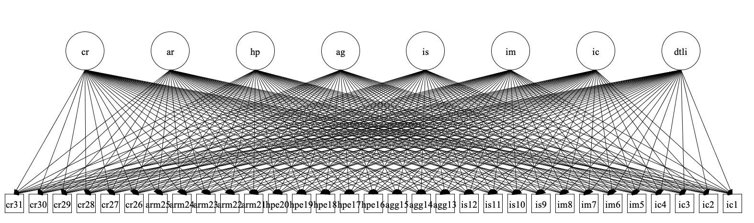
Model 20. DTLI ESEM within CFA bifactor
Notes:
Model 20

